Slide 1
Mandatory Access Control
Lesson Introduction
Understand need for mandatory access control (MAC) and multi-level security
Explore several MAC models
Understand assurance techniques for a trusted computing base (TCB)

Slide 2
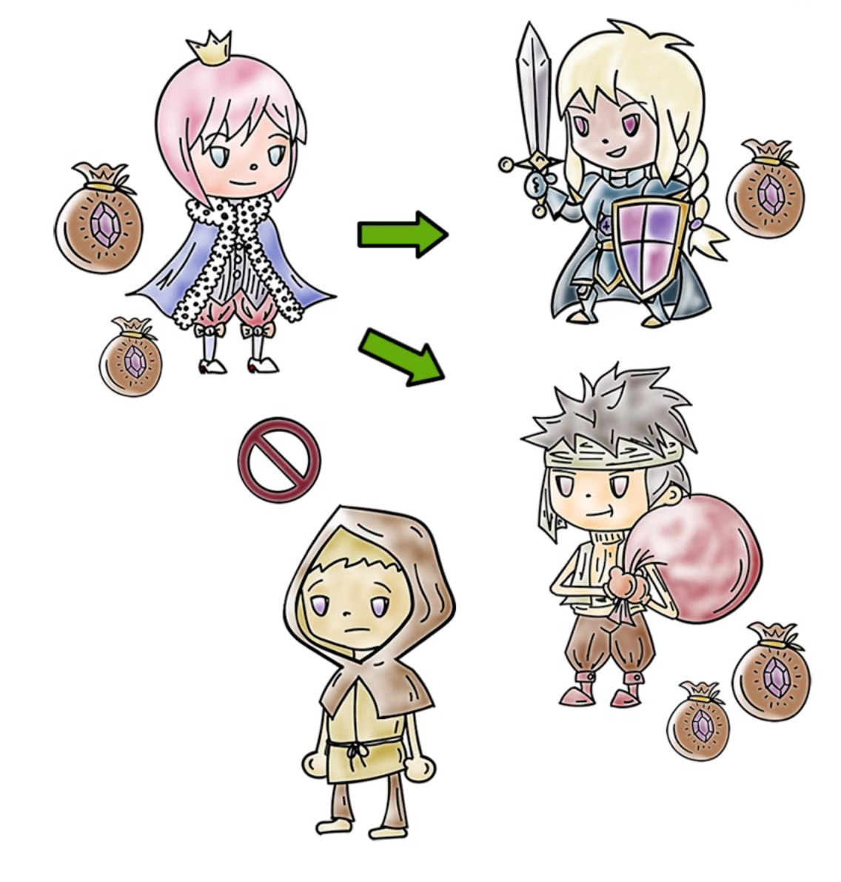
Discretionary Access Control
In discretionary access control (DAC), owner of a resource decides how it can be shared
Owner can choose to give read or write access to other users

Slide 3

Discretionary Access Control
Two problems with DAC:
You cannot control if someone you share a file with will not further share the data contained in it
Cannot control “information flow”
In many organizations, a user does not get to decide how certain type of data can be shared
Typically the employer may mandate how to share various types of sensitive data
Mandatory Access Control (MAC) helps address these problems

Slide 4

DAC Quiz
Check the best answer:
In a certain company, payroll data is sensitive. A file that stores payroll data is created by a certain user who is an employee of the company. Access to this file should be controlled with a...
DAC policy that allows the user to share it with others judiciously
It must use a MAC model as the company must decide who can access it

Slide 5

Mandatory Access Control (MAC) Models
User works in a company and the company decides how data should be shared
Hospital owns patient records and limits their sharing
Regulatory requirements may limit sharing
HIPAA for health information

Slide 6

Mandatory Access Control (MAC) Models
Military and intelligence agencies:
Data has associated classification level and users are cleared at various levels
Top secret, secret, confidential etc.
Limits on who can access data at a certain level
User cleared only at secret level should not be able to access top secret data
Also called multilevel security (MLS)

Slide 7

Implementing MAC
Labels: A Key Requirement for Implementing MAC
indicate sensitivity/category of data or clearance/need-to-know requirements of users
TCB associates labels with each user and object and checks them when access requests are made
Need to relate labels to be able to compare them
Exact nature of labels depends on what kind of model/policy is implemented
DoD models include classification/clearance level and a compartment in the label
Commercial policies are different but use labels to deal with conflict-of-interest, separation-of-duty etc.

Slide 8
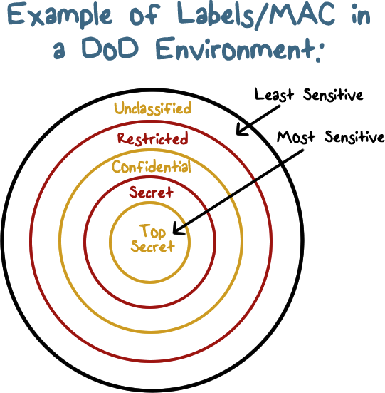
Implementing MAC
Label = (sensitivity level, compartment)
Let us consider highly sensitive documents that have information about various arms stockpiles.
L1 = (TS, {nuclear, chemical})
L2 = (S, {nuclear, conventional})
Providing confidential access to documents (Bell and La Padula or BLP Model)

Slide 9
Health Data Quiz
Check the best answer:
A hospital is found to be lax in securing access to patient records after it suffers a major breach. It may have violated the following policy:
HIPAA
BLP

Slide 10
Security Clearance Quiz
Check the best answer:
Highly sensitive defense or intelligence information should only be accessed by cleared personnel. Approximately, how many people in the United States have various types of clearances?
10,000
1,000,000
100,000
5,000,000

Slide 11
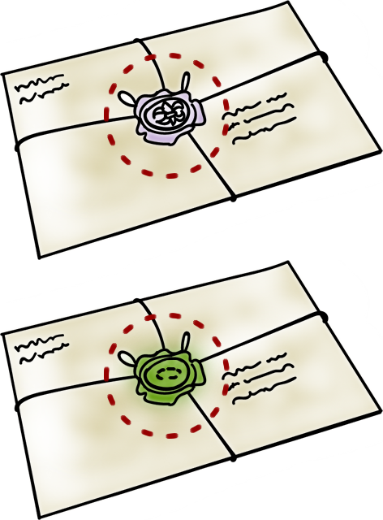
Comparing Labels
Assume sensitivity levels are totally ordered (TS > S > C > U)
Compartments are sets which can only be partially ordered
How do we order labels?

Slide 12
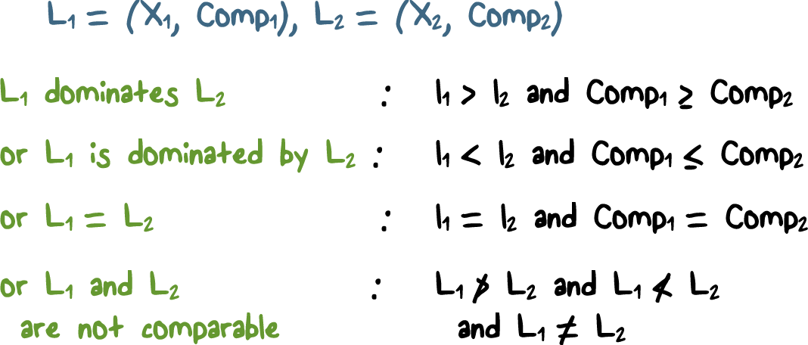
Comparing Labels

Slide 13
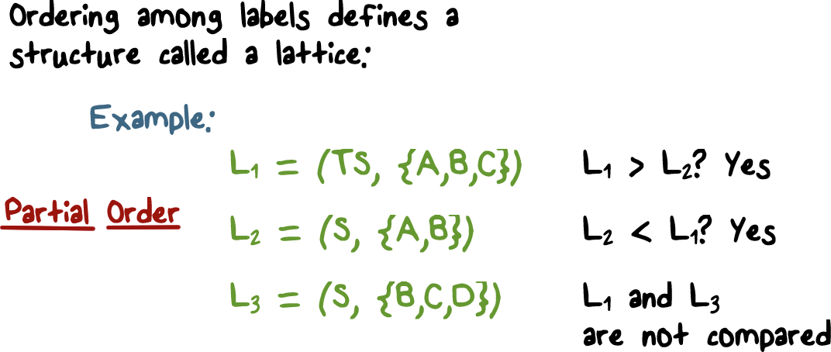
Ordering Among Labels

Slide 14
Order Quiz
Select the best answer:
The “<” relation among all real numbers defines a...
Total order
Partial order

Slide 15
Label Domination Quiz
Select the best answer:
If L1 = (secret, {Asia, Europe}) and L2 = {top-secret, {Europe, South-America}),
L1 dominates L2
L2 dominates L1
Neither L1 nor L2 dominates the other one

Slide 16
Sensitive Data Quiz
Select the best answer:
Assume that label L1 or a document D1 dominates label L2 of document D2 when these labels are defined by (sensitivity level, compartment).
D1 contains more sensitive data than D2.
D2 is more sensitive than D1.
The data contained in D2 has a narrower scope
as defined by its compartment

Slide 17
Using Labels for MAC: Confidentiality
Bell and La Padua or BLP Model (Developed by DoD)
Assumes classification of data (TS, S, C, U) and clearances for subjects
Read/write rules
User with label L1 can read document with label L2 only when L1 dominates L2
Read-down rule (simple security property)
User with label L1 can write document with label L2 when L1 is dominated by L2
Write-up rule (star property)

Slide 18
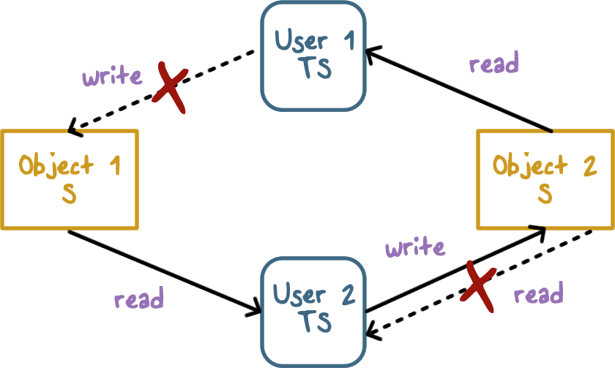
Preventing Information Flow with BLP

Slide 19
Unclassified Documents Quiz
Select the best answer:
Since an unclassified document contains no sensitive information, it can be read or written by anyone in a system that implements BLP
True
False

Slide 20
Classified Data Quiz
Select the best answer:
BLP allows an unclassified user to write a top secret document.
True
False

Slide 21
BLP Model Quiz
Tranquility principle in the BLP model states that classification of a subject or object does not change during a session. This principle is needed to avoid...
Select the best answer:
Information flow that may violate confidentiality requirements defined by BLP
To reduce overhead associated with change
of classification level

Slide 22
Other MAC Models
Biba is dual of BLP
Focuses on integrity rather than confidentiality
Read-up and write-down rules
Example:
Integrity level could be high, medium or low
Compartment could be similar to BLP and captures topic(s) of document
Low integrity information should never flow up into high integrity documents

Slide 23

Policies for Commercial Environments
User clearance is not common
Other requirements exist
Data only be accessed by certain application (e.g., payroll)
Separation-of-duty and conflict-of-interest requirements

Slide 24
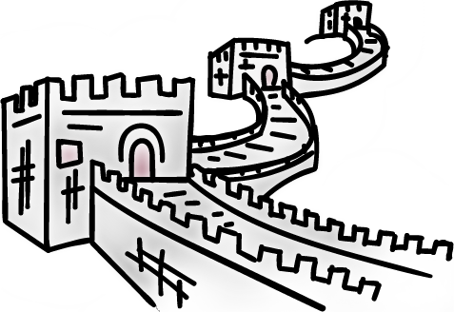
Policies for Commercial Environments
Users ➔ Programs (transactions) ➔ Objects
Clark-Wilson Policy
Same user cannot execute two programs that require separation-of-duty
Chinese Wall Policy
Deals with conflict of interest

Slide 25
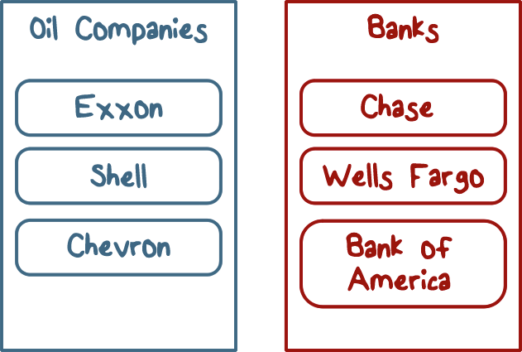
Chinese Wall Policy (Conflict of Interest)
Objects are put into conflict classes:
The user can access any object as long as he/she has not accessed an object from another company in the same conflict class.

Slide 26
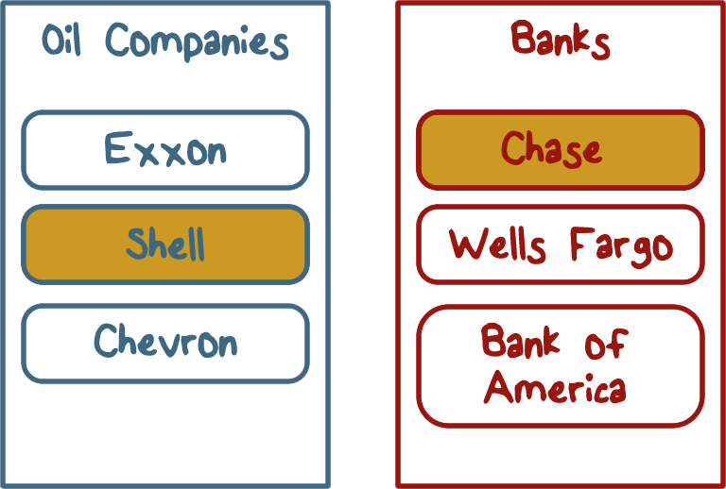
Policies for Commercial Environments

Slide 27
Clark-Wilson Quiz
Select the best answer:
Clark-Wilson is a mandatory access control
policy because...
Any user in a company can decide what files can be accessed by a program
Only the company can decide (e.g., sysadmin) what files can be accessed by a program.

Slide 28
CoI Quiz
Select the best answer:
A large law firm currently has two client companies that compete with each other. Thus, its lawyers working on cases related to one company must not be able to access documents related to the other company. To ensure proper access control, which policy should the law firm use?
Clark-Wilson
Chinese Wall

Slide 29
RBAC Quiz
Select the best answer:
Role-based access control (RBAC) is often used in a commercial setting. RBAC is an example of MAC because...
File permissions are associated only with roles and not users
Only the company can decide roles of its employees

Slide 30
MAC Support Quiz
Select the best answer(s):
Which of the following operating systems supports a BLP-like model?
SELinux
MacOS
Windows
SCOMP

Slide 31

Trusted Computing Bases (TCB)
Revisiting Trusted Computing Base (TCB)
How do we know TCB can be trusted?
Secure vs. trusted. vs high assurance
Set of all hardware and software trusted to operate securely
Required for all other trust in the system security policy

Slide 32
Trusted Computing Bases (TCB)
Trusting Software:
Functional correctness
Does what it was designed to do
Maintains data integrity
Even for bad input
Protects disclosure of sensitive data
Does not pass to untrusted software
Confidence
Experts analyze program & assure trust
Statement giving security we expect system to enforce
Do this formally when and where possible

Slide 33
TCB Design Principles
Least privilege for
users & programs
Economy
Keep trusted code small as possible, easier to analyze & test
Open design
Security by obscurity does not work
Complete mediation
Every access checked, attempts to bypass must be prevented
Fail-safe defaults
Default deny
Ease of use
Users avoid security that gets in their way

Slide 34
Least Privilege Quiz
Select the best answer:
Least privilege is useful for damage containment when something goes wrong. Is this principle applicable to a TCB that must be trusted?
No, because a TCB is guaranteed to function correctly
Yes, because TCB only provides high assurance and not a guarantee

Slide 35
TCB High Assurance Quiz
Select the best answer:
A TCB vendor claims its proprietary techniques help ensure high assurance, but cannot be disclosed. What principle does it violate?
Complete mediation
Open design

Slide 36
Design Principle Quiz
Select the best answer:
A home wireless router comes with a setting that does not encrypt traffic unless security settings are explicitly enabled. This violates...
Ease of use principle
Fail-safe default principle

Slide 37
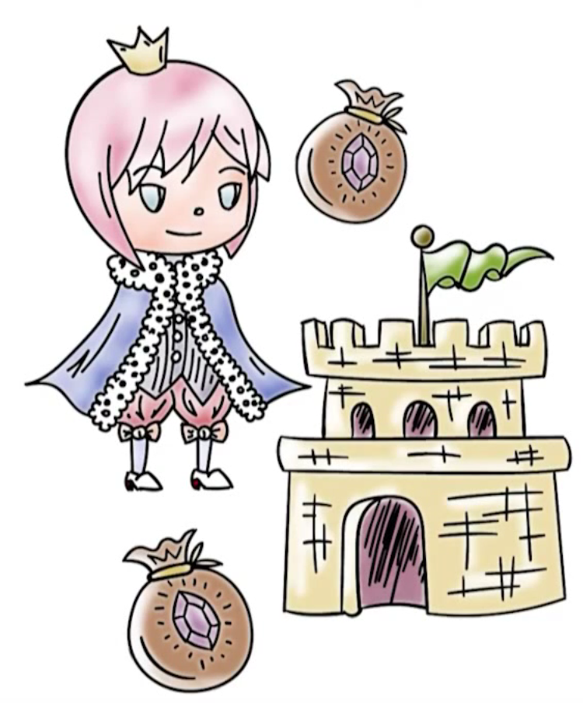
How Do We Build a TCB: Support Key Security Features
Must implement certain security relevant functions
Authentication
Access control to files & general objects
Mandatory access control (SELinux)
Discretionary access control (standard file permissions)

Slide 38
How Do We Build a TCB: Support Key Security Features
Protection of data used by OS (OS must protect itself)
Security features of trusted OSes
Object reuse protection
Disk blocks, memory frames reused
Process can allocate disk or memory, then look to see what's left behind
Trusted OS should zero out objects before reuse
Secure file deletion: overwrite with varying patterns of zeros & ones
Secure disk destruction: degaussing, physical destruction

Slide 39
How Do We Build a TCB: Support Key Security Features
Complete mediation of accesses
Trusted path from user to secure system
Prevents programs from spoofing interface of secure components
Prevents programs from tapping path (e.g. keyloggers)
Audit log showing object accesses – only useful if you /look/ at the log
Detect unusual use of the system

Slide 40

Kernel Design
Security kernel enforces all security mechanisms
Good isolation, small size for verifiability, keeps security code together
Reference monitor controls access to objects (monitors all references to objects)
Tamperproof [impossible to break or disable]
Un-Bypassable [always invoked, complete mediation]
Analyzable [small enough to analyze & understand]

Slide 41
Kernel Design
What is included in the trusted computing base (TCB)?
All parts of OS needed for correct enforcement of security policy
Handles primitive I/O, clocks, interrupt handling, hardware capabilities, label checking
Virtualization
Virtual machine provides hardware isolation, logical OS separation

Slide 42

Revisiting Assurance
Assurance: Ways of convincing ourselves
that a model, design, & implementation are correct
Methods of assurance validation:
Testing /Penetration testing
Formal verification Validation
Checking that developers have implemented all requirements
Requirements checking, design & code reviews, system testing

Slide 43

Revisiting Assurance
Testing:
Demonstrate existence of problem
Cannot demonstrate absence of problem
Regression testing: ensure that alterations do not break existing functionality / performance (regression: “going backwards”)

Slide 44
Revisiting Assurance
Challenges:
Test case generation
Code coverage
Exponential number of different executions
Different execution environments
Penetration testing:
Ethical hackers attempt to defeat security measures
Cannot demonstrate absence of problem

Slide 45
Revisiting Assurance
Formal verification: Checking a mathematical specification of program to ensure that security assertions hold.
Model checking, automated theorem proving
State variables w/ initial assignment, program specification describing how state changes, boolean predicates over state variables
Difficulty: exponential time & space worst case complexity
Model checking pioneers won the 2007 Turing Award

Slide 46
Reducing TCB Size Quiz
Check all applicable answers:
We discussed the need for reducing the size of the TCB. This helps with...
Testing of the TCB
Verification of the TCB
Isolation of the TCB

Slide 47
Testing TCB Quiz
Check the correct answer:
Testing is challenging for a complex system like a TCB because of...
It is hard to cover all executions
It can show both existence and absence of problems

Slide 48
Model Checking Quiz
A key problem with model checking is...
It cannot show absence of a problem
It does not scale to practical large size systems

Slide 49
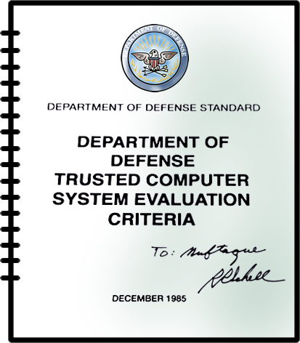
Security Evaluations

Slide 50

Government Security Evaluations
U.S. Orange Book (late 1970's)
D < C1 < C2 < B1 < B2 < B3 < A1
D: no protection
C: discretionary protection
B: mandatory protection
A: Verified protection
C1, C2, B1: security features common to commercial OSes
B2: Proof of security of underlying model, narrative spec of TCB
B3, A1: Formal design & proof of TCB

Slide 51
Government Security Evaluations
Common Criteria (2005) international standard
replaced orange book
Originated out of European, Canadian, and US standards
Idea: users specify system needs, vendors implement solution and make claims about security properties, evaluators determine whether vendors actually met claims
Evaluation assurance level (EAL) rates systems
EAL1 most basic, EAL7 most rigorous

Slide 52
TCSEC Divisions Quiz
Many widely used operating systems do not support MAC and hence cannot be in a TCSEC division higher than...
D
C

Slide 53
Earning an EAL4
Certification Quiz
How did VMware vCloud Networking and Security
v5.5 system receive an EAL4+ certification?
The system developers used formal techniques in its design and testing
A systematic review and testing process was used by the system developers

Slide 54
Cost-Benefit Certification Tradeoffs Quiz
Many OS vendors do not aim for the highest certifications because...
There is no market demand for such certifications
Cost/benefit tradeoffs dictate the highest certification

Slide 55
Mandatory Access Control
Lesson Summary
Provides enterprises an ability to control how sharing of sensitive information can be controlled
Can address both confidentiality and integrity but require added functionality with labels
High level of assurance for trusted systems is challenging

